Slide 1

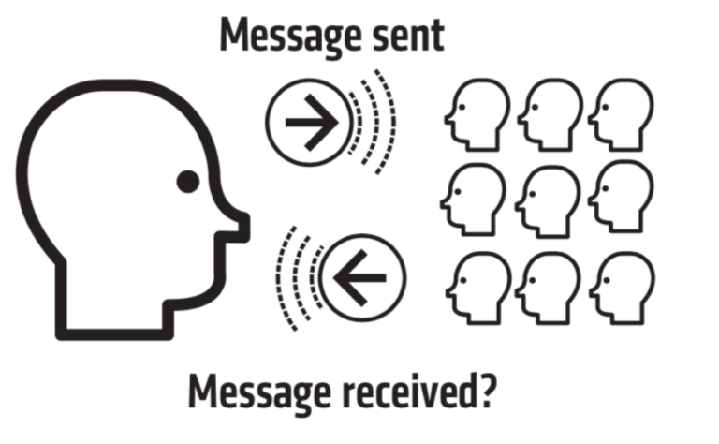
Feedback and responsive teaching
At BIS, teachers reflect on what type of feedback has the best opportunity to help improve the learner. Therefore, written feedback inside a book is not compulsory in student notebooks. Teachers rely on written feedback in books less, instead using a variety of feedback strategies depending on the task and the student.
Notes:
N

Slide 2
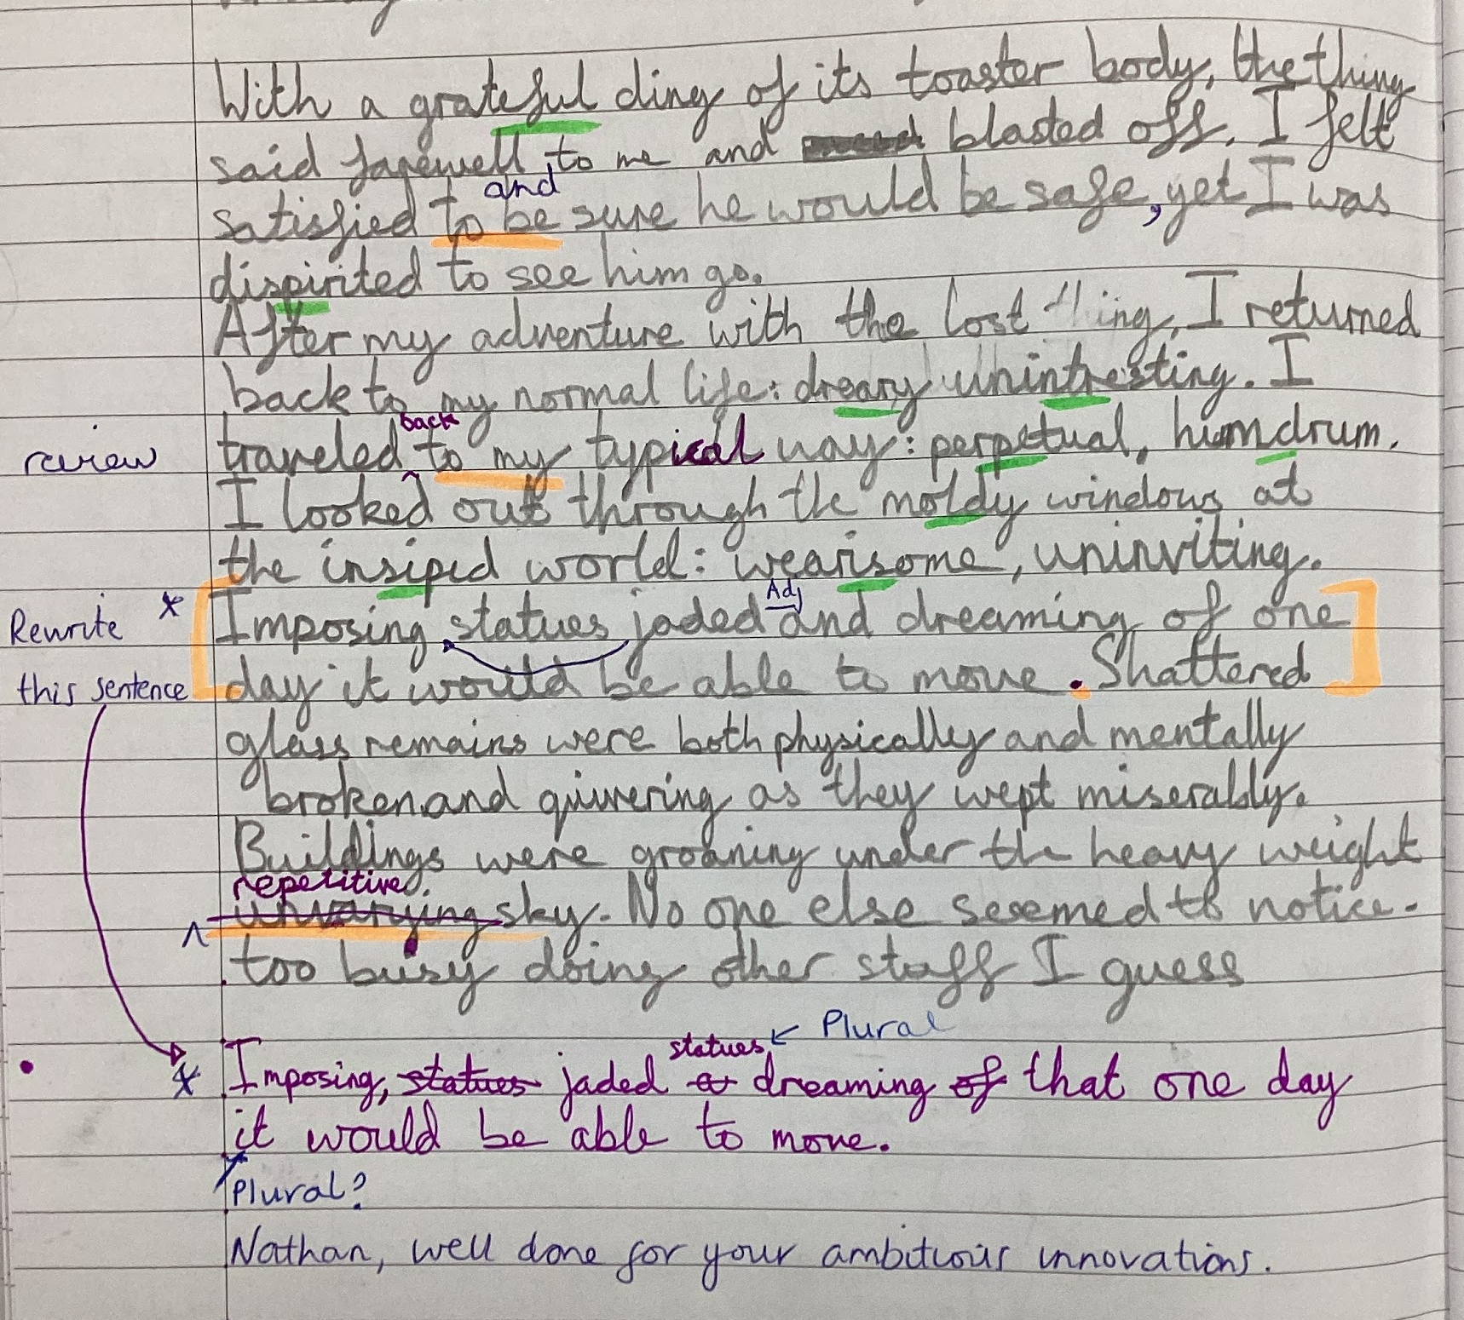
Feedback and responsive teaching
Children should know how they are doing in their learning and what their next steps are.
Feedback strategies can include:
using whole class feedback strategies
developing self-assessment strategies
using activities to support and challenge students in following lessons
1:1 writing conferences with teacher & student
using written marking ‘in the moment’ with students
who respond using feedback pens (see example)
Using peers as resources for feedback
Notes:
N

